Slide 1
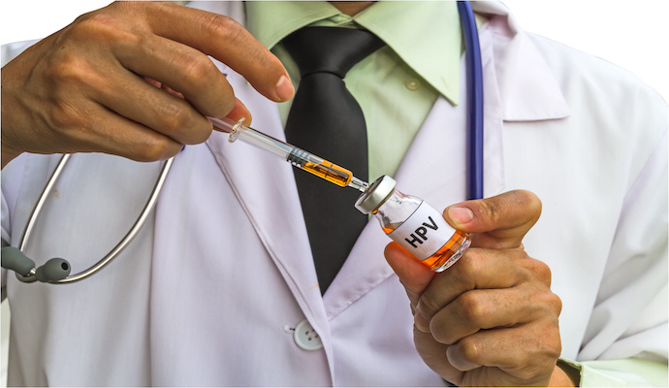
Cancer Vaccines Gardasil Case
Presented by:
Souhaib Khalbuss || 19017924
Moutesem Shakdouh || 19017910

Slide 2
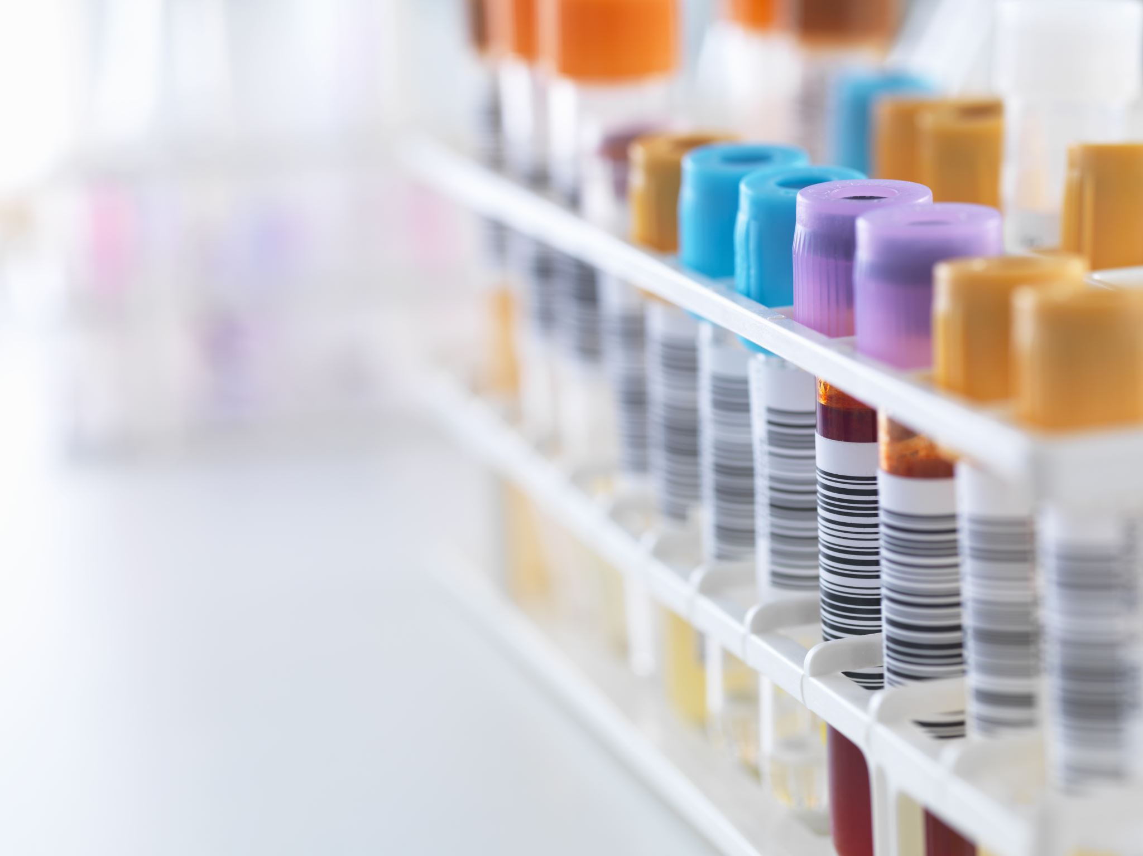
Presentation Outline
Cancer
Cancer Vaccines
Human Papilloma Virus (HPV)
Gardasil, Gardasil-9 and Cervarix Vaccines
Gardasil: How is it manufactured?
Gardasil Vaccine: Who should get this vaccine and how popular is it?

Slide 3

What is cancer:

Slide 4

In the United States one in every four people die from a cancer.
Despite these enormous numbers most individuals do not know what that really means. That is why we must be aware of the risk and take action.

Slide 5
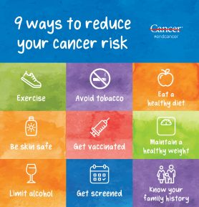
How can we prevent cancer

Slide 6
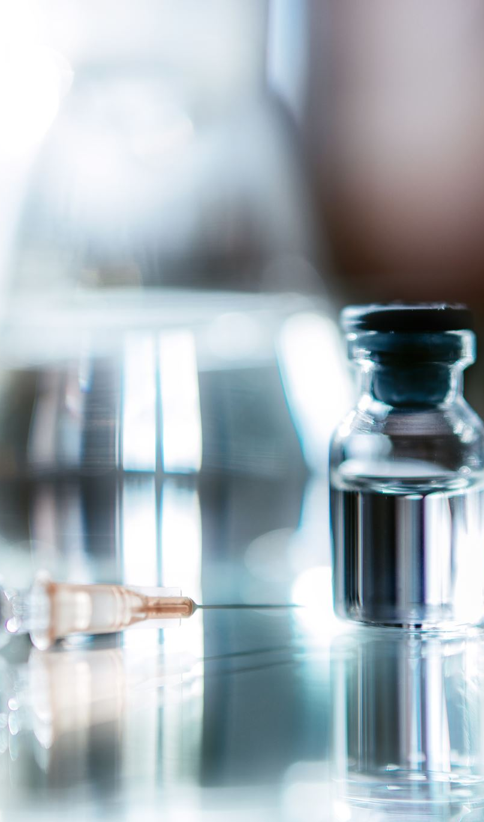
Cancer vaccines
Prophylactic Cancer Vaccines: focus on introducing the antigens or viruses to the immune system.
Therapeutic Cancer vaccines: focus on killing existing tumor.

Slide 7
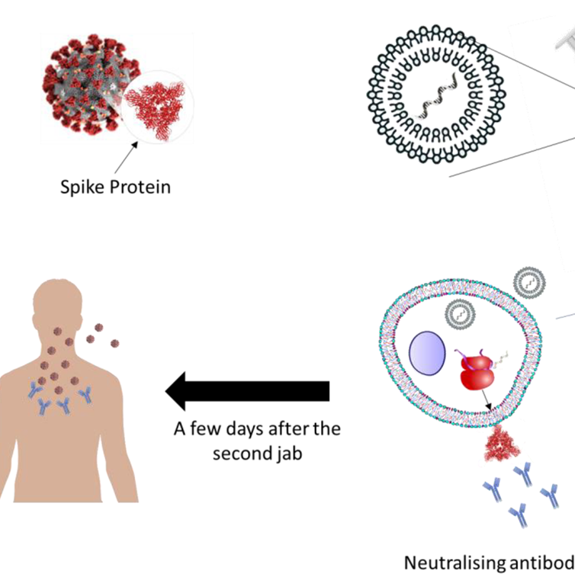
Making treatment vaccines that work is a challenge because:
Cancer cells suppress the immune system.
Cancer cells start from a person’s own healthy cells.
Larger or more advanced tumors are hard to get rid of using only vaccines.

Slide 8
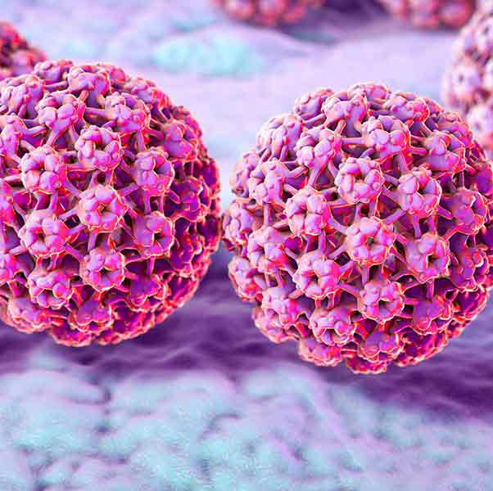
Human Papilloma Virus (HPV):
Belongs to the Papillomaviridie family.
Double-stranded circular DNA.
Most commonly causes sexually transmitted diseases (STDs) such as cervical, vaginal, vulvar and anal Cancers and genital wart.

Slide 9

Transmitted primarily through: a)Skin-to-skin b) Skin-to-mucosa c) Mucosa-to-mucosa
Facts:
There are more than two hundred HPV types.
Mainly infect cutaneous and mucosal tissues.
High risk or oncogenic HPV types {HPV18}.
Low risk or non-oncogenic HPV types {HPV6}.

Slide 10
In general, HPV is associated with:
More than 90% of anal and cervical Cancers.
About 70% of vaginal vulvar and oropharyngeal Cancer.
More than 60% of penile Cancer.
More than 10% of oral cavity Cancer

Slide 11
What are the Cancer Vaccines types?
Prophylactic (Preventive):
Therapeutic:
Prevent cancers caused by certain viruses.
They work by inducing an immune response to specific viral antigens, thereby preventing viral infections that can lead to cancer.
Unlike preventive vaccines, therapeutic cancer vaccines treat existing cancer by strengthening the body's natural immune response against the cancer.
These vaccines are designed to treat, rather than prevent cancer.
They work by introducing one or more antigens into the body to stimulate an immune response against specific cancer cells.
HPV Vaccines (like Gardasil and Cervarix)
Hepatitis B Vaccine: prevents hepatitis B virus infection, which can lead to liver cancer.
Tumor Cell Vaccines.
Antigen Vaccines.
DNA Vaccines.
Vector-Based Vaccines.

Slide 12
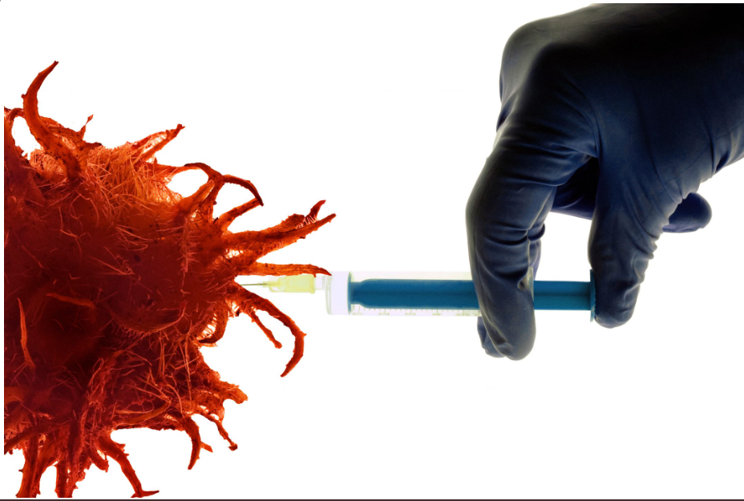

HPV Vaccines (Gardasil-Case):
Targeted HPV Types:
Cervarix
16, 18
Gardasil
6, 11, 16, 18
Gardasil-9
6, 11, 16, 18, 31, 33, 45, 52, 58

Slide 13
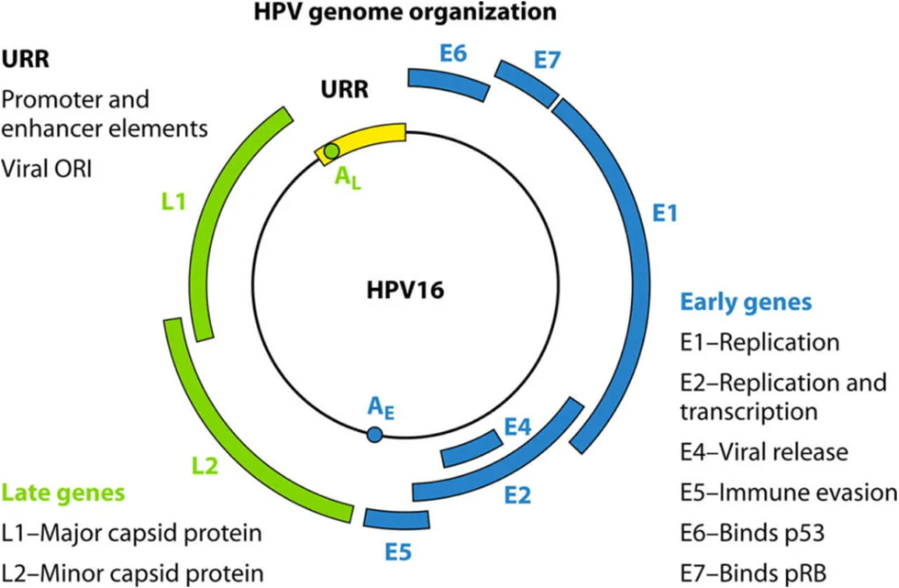
Gardasil: How is it manufactured?
3 main regions:
Early
Late.
Long Control (LCR)

Slide 14
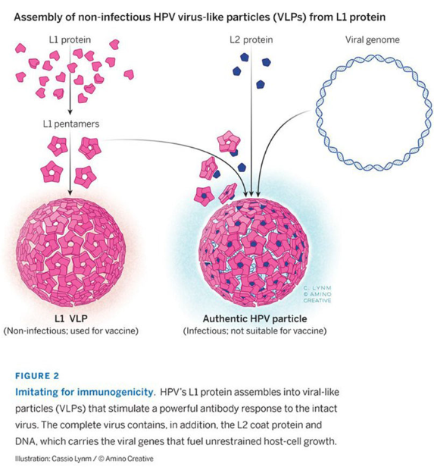
Gardasil Formation:
Virus-like particles (VLPs) can be synthesized using bacterial, yeast, or insect cell systems.
Gardasil is formulated with VLPs from the L1 protein of several HPV types, specifically types 6, 11, 16, and 18.
The production of Gardasil employs the pGALlio yeast expression system, utilizing the Brewer's yeast.

Slide 15
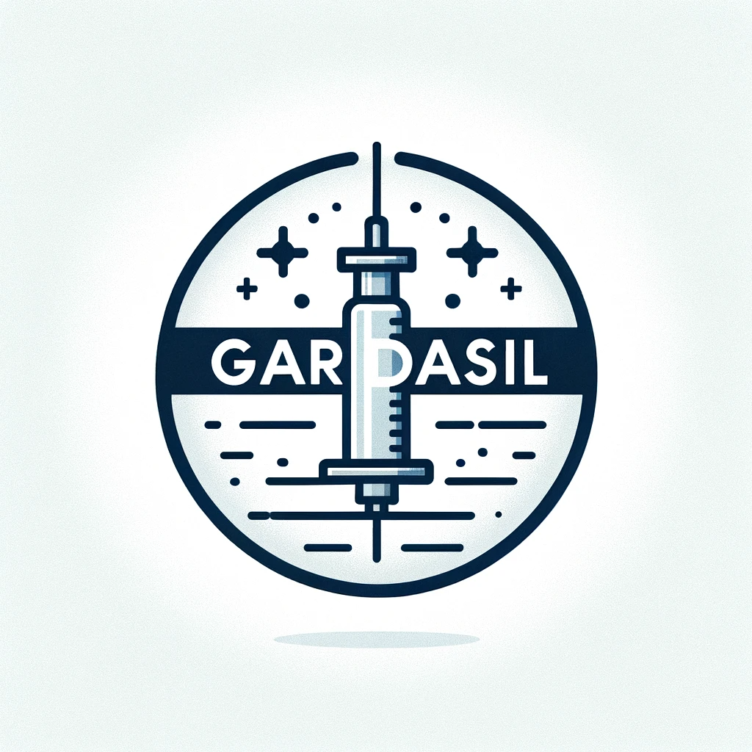
Who should get this vaccine and how popular is it?
CDC advises two doses for children starting at ages 11 or 12; three doses if the series starts after age 15.
Recommended for ages 9-26 and 27-45.
Guards against genital warts and precancerous growths in men. And helps reduce the spread of the virus among men.
Not Recommended for the pregnant women.

Slide 16

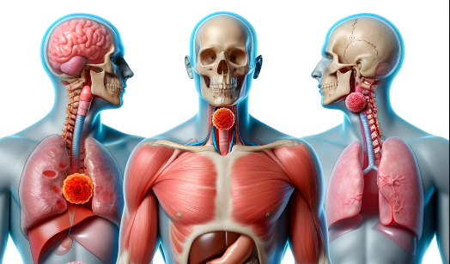
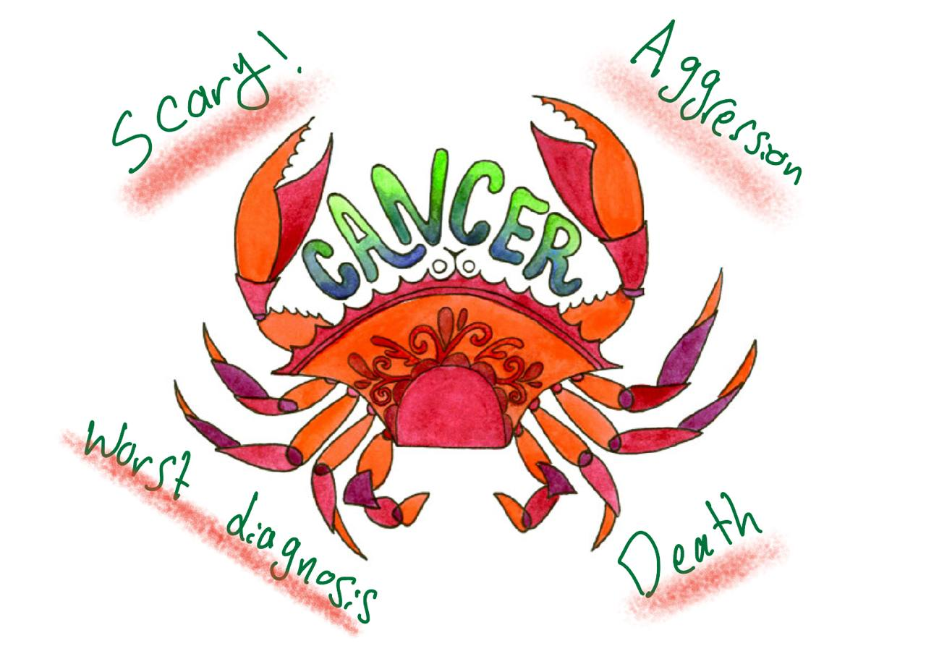

Slide 17
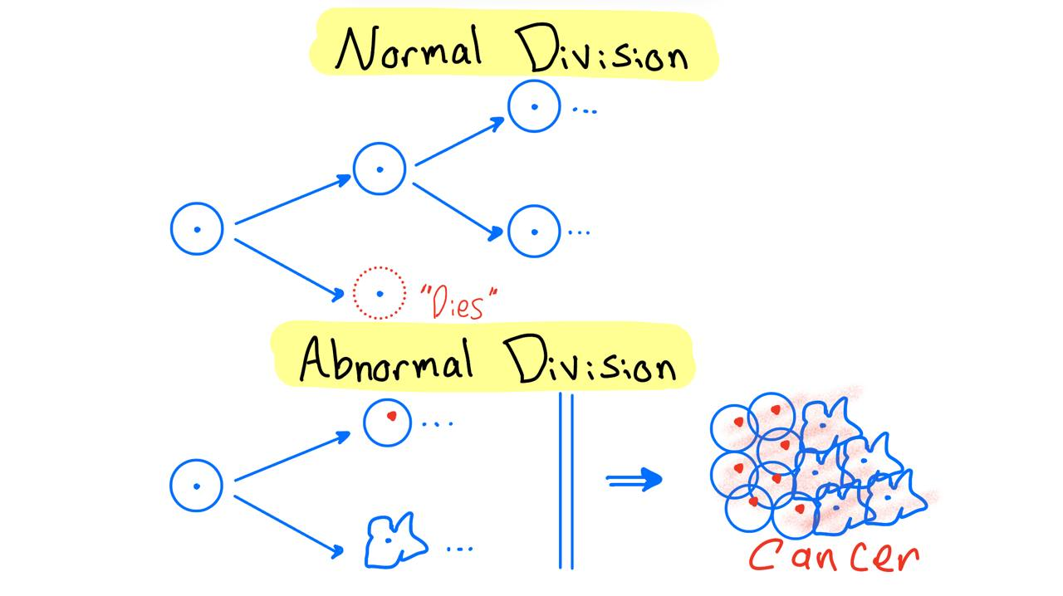

Slide 18
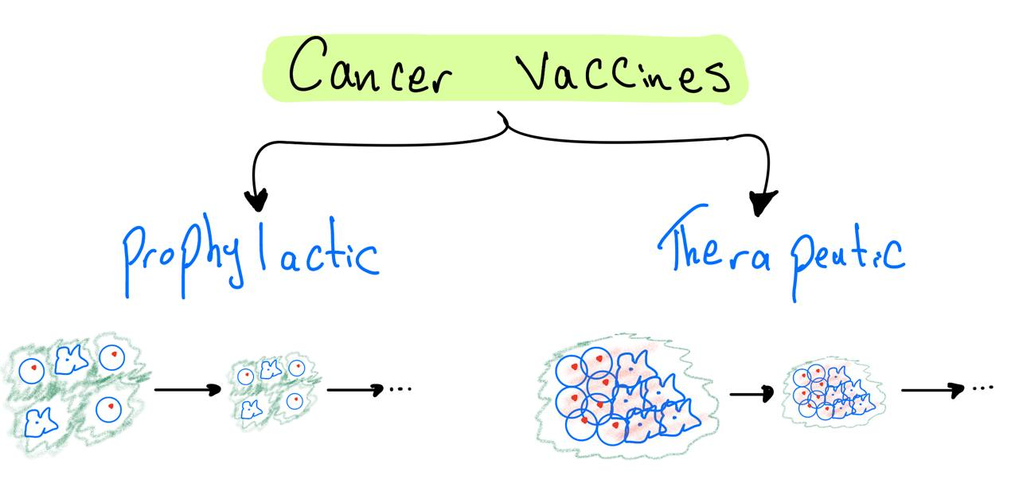

Slide 19
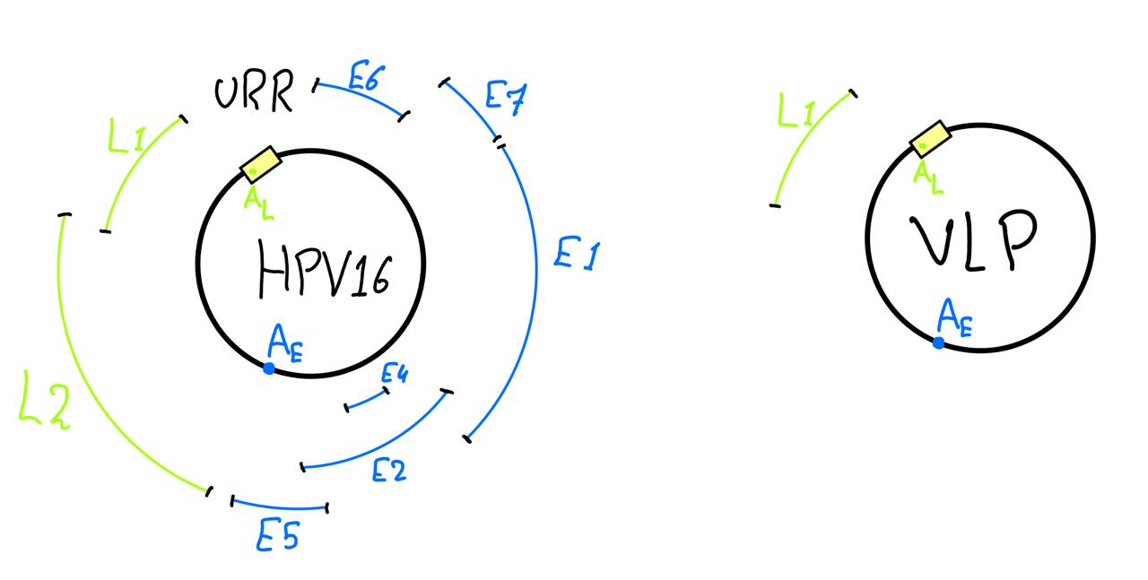

Slide 20
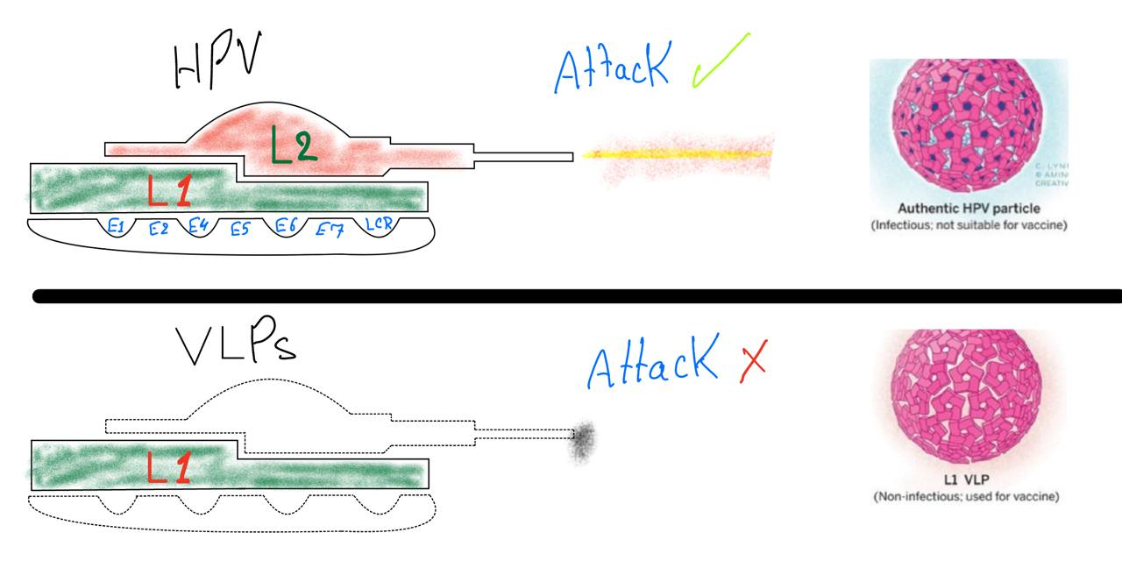

Slide 21
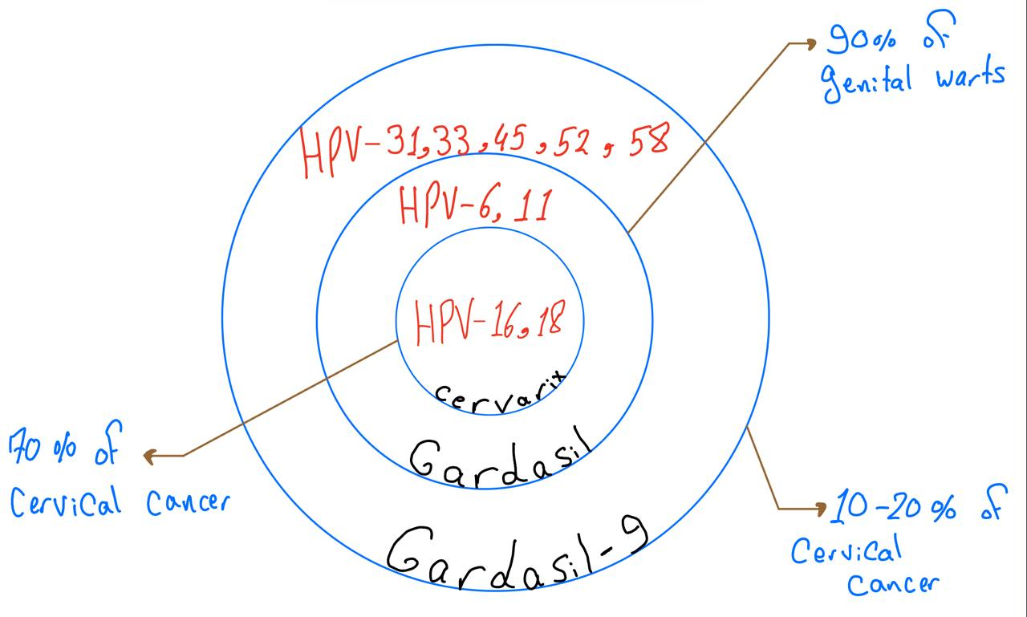

Slide 22

Thank You!

